Slide 1
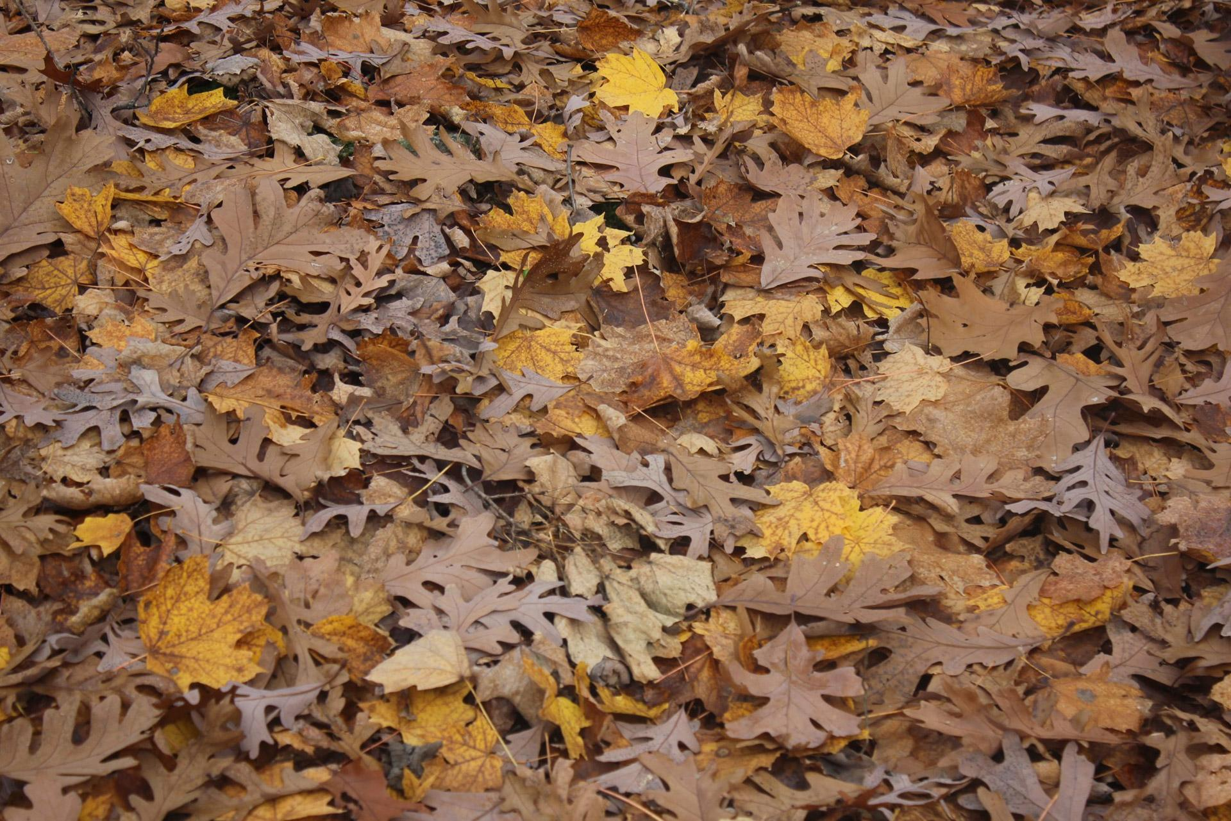
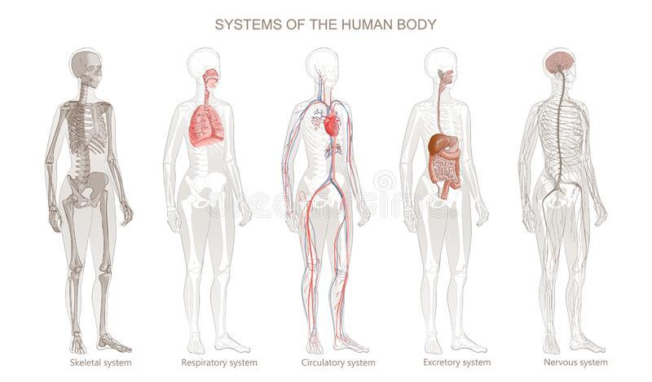
Leaf Litter and
the Human Body

Slide 2
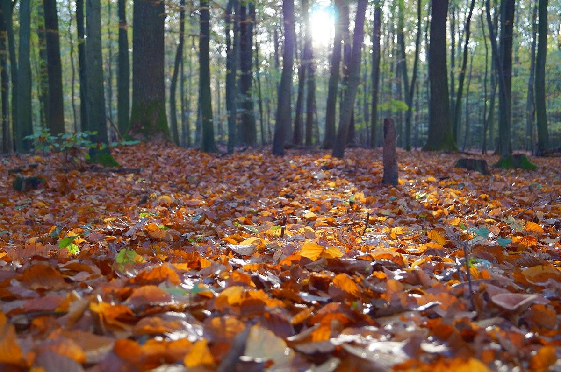

“A forest is a living thing like a human body...each part dependent on all the other parts. A forest needs its birds, its beaver...all its animals and plants. The forest gives shelter to the birds, but they repay the debt with the insects they eat, the droppings they leave, the seeds they carry off to plant elsewhere. The beaver builds dams for himself, but the dams keep water on the land, and although the beaver cut trees to use and to eat, their ponds provide water for the trees during the hot, dry months....Listen, and you can hear the forest breath.”
― Louis L'Amour, Bendigo Shafter

Slide 3
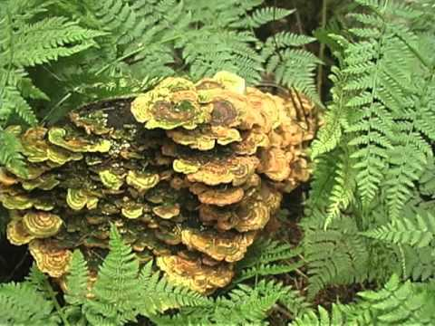
https://www.youtube.com/watch?v=n1i1ckTF4zk
Notes:
This 5 minute video does not have any words. You could invite students to write down as many biotic elements they see, or split up teams and have some write down plants, animals or fungi. You could also just watch the video as a peaceful introduction.

Slide 4
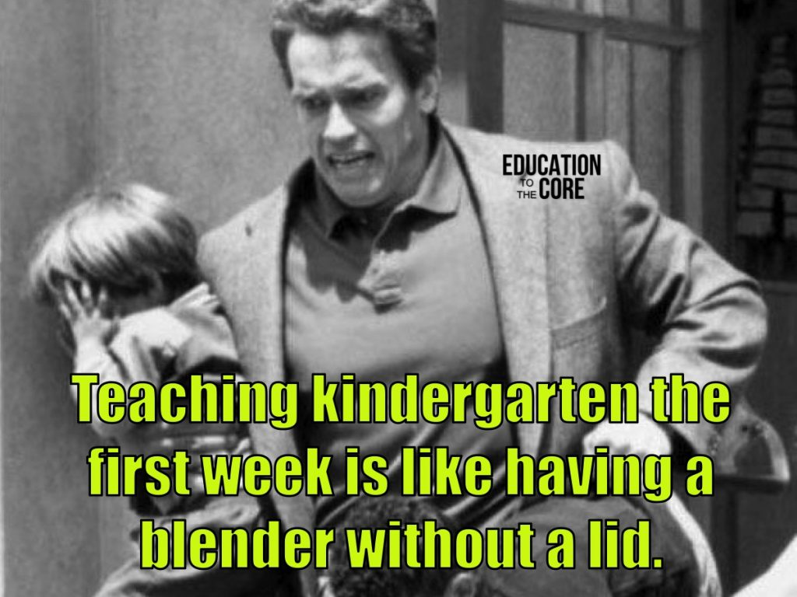
Today we are going to make analogies between our human body systems and leaves that lay on the ground (leaf litter). Let’s first understand an analogy:

Slide 5
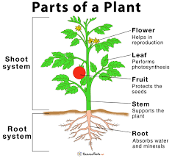
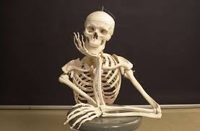
A plant example:
Stem Structure Function:
Stems are like the skeleton of a plant because they support the plant to stand upright and hold the leaves.
Explanation

Slide 6
On the forest floor ________ are like the skeletal system because…
From your research, what on the forest floor acts like the function of this human body system?
In this box
explain
how it is
like this system
Explanation

Slide 7
Directions: After completing your research below, write your analogies on the following slides!
Read or Watch About to Review the Functions of Each Human Body System or the one you are assigned
Human Body Systems WSFCS
Seer: Introduction to Body Systems
Videos:
Amoeba Sisters
EleSapians
Read or Watch About to Learn about the Functions of Leaves on the Forest Floor:
Life in the Leaf Litter from American Museum of Natural History

Slide 8
On the forest floor ________ are like the skeletal system because…

Slide 9
On the forest floor ________ are like the respiratory system because…

Slide 10
On the forest floor ________ are like the circulatory system because…

Slide 11
On the forest floor ________ are like the excretory system because…

Slide 12
On the forest floor ________ are like the nervous system because…

Slide 13
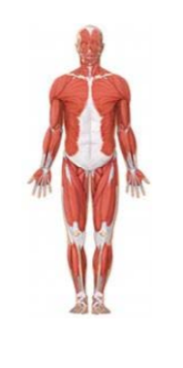
On the forest floor ________ are like the muscular system because…

Slide 14
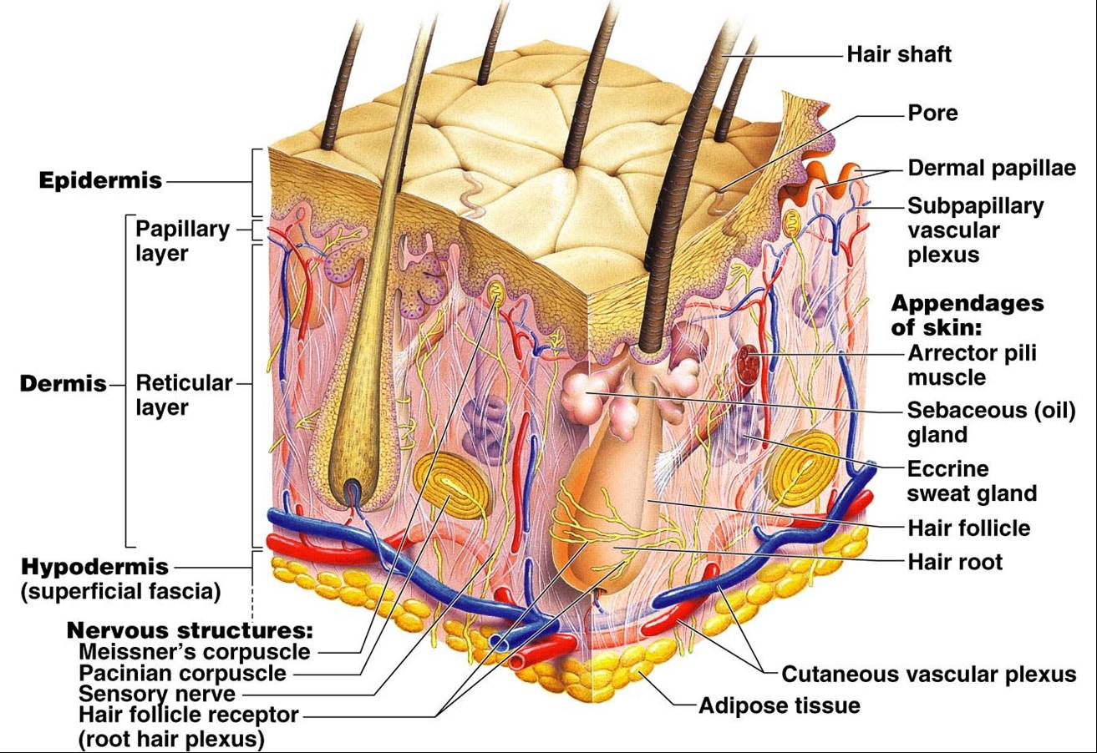
On the forest floor ________ are like the integumentary system because…

